Slide 1
SHORT AND LONG TERM DATA ANALYTICS & RECOMMENDATIONS USING THE 2016-2020 VEHICLE ACCIDENT DATA OF THE UNITED KINGDOM

Slide 2
Abstract
The project discusses the analysis of road accidents of 5 years from the year 2016 to the year 2020 in the United Kingdom.
The data was analyzed using Wolfram code in Mathematica.
The problem was treated as a prediction problem, with additional exploratory analysis.
The results have been visualized using bar graphs, line charts, etc.
By using statistical methods patterns were examined within various circumstances of the accidents.
Attention was also given to a specific short period of pandemic lockdown and the immediate effects on vehicle accident frequency.

Slide 3
Content
Introduction
Data Model & Source
Methodology
Results
Conclusion
References

Slide 4
Introduction
The UK government has put its efforts into building an aggregated collection of accident records in the England, Scotland, and Wales regions over a years.
Having access to this traffic data sets, we work towards uncovering patterns and answering questions related to the potential causes and trends of accidents.
This report is focused on data from 2016-2020 as we believe the advancements in technology related to motor vehicles from this period are similar.
The data was obtained by downloading directly onto our computers and imported into Wolfram Mathematica where the analysis was conducted.

Slide 5
We have conducted analysis in two major parts:
Long term analysis :
This section aimed to examine various trends of vehicle accidents between 2016 and 2020 using exploratory analysis
2. Short term close-up analysis:
In this analysis we focused on the pandemic lockdown situation and its effects on the vehicle accidents.

Slide 6
Data Model and Methodology
The data for this project is obtained from information on the United Kingdom’s Government Open Data website.
In particular, files “Road Safety Data – Accidents 2020”, “Road Safety Data – Accidents 2019”, “Road Safety Data – Accidents last 5 years” were used. The “Road Safety Data – Accidents last 5 years” file contained 36 pieces of detailed information about each of 597 973 vehicle accidents that took place in the UK between 2016-2020.
The dataset gives a detailed information of each accident that has taken place during 2016-2020 including information like the date, location, severity of the accident, casualties in each accident, weather and light condition in the spot of accidents and more.

Slide 7
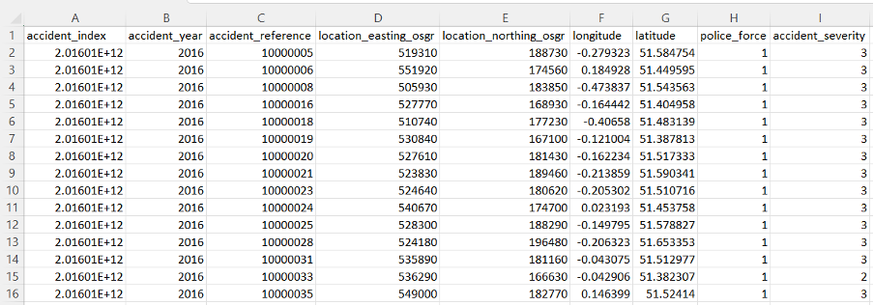

Slide 8
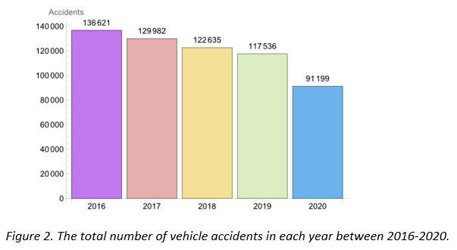
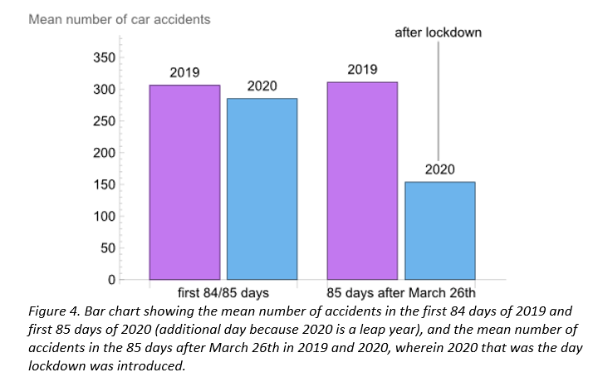
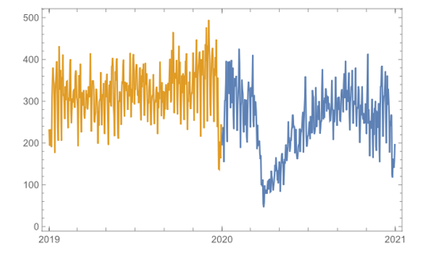

Results - Yearly accidents and effect of lockdown

Slide 9
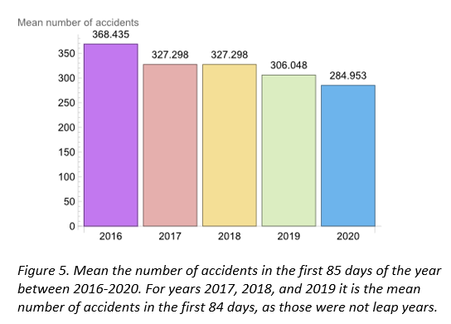
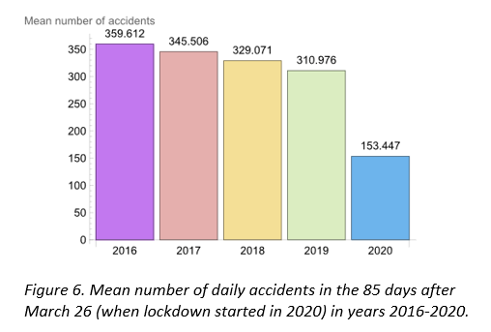
Results - first 85 days of the year and 85 days after March 26th

Slide 10
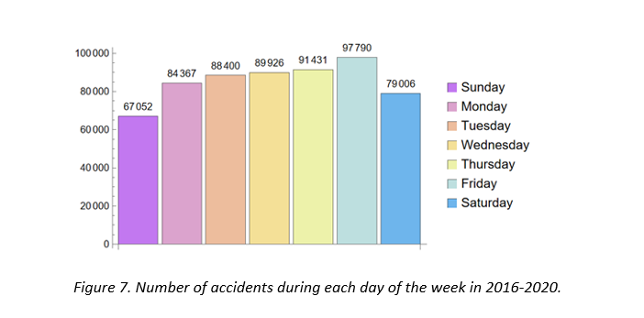
Results - day wise trend
Highest daily accidents: Friday
Lowest daily accidents: Sunday
Daily accidents go up from Monday till Friday, then drop over the weekend.

Slide 11
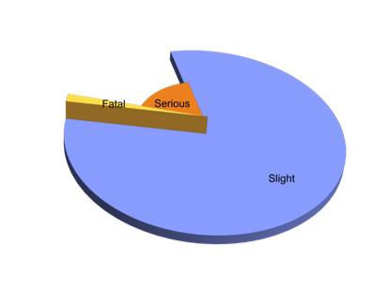
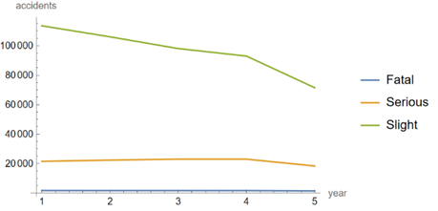
Results: Analysis based on Accident Severity
Overall Analysis
Pie Chart displays mostly accidents of slight severity and very few with fatal severity
LineChart displays the number of accidents decreasing over the years
In 2017, Serious accidents had a slight increase.
Functions used:
Part: rows-all, columns-year & accident severity
ListLinePlot: Display chart as a line graph
PieChart: Display proportion of accidents caused by each severity yearwise.

Slide 12
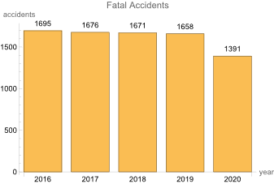
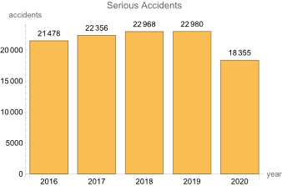
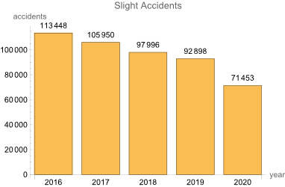
In Detail Analysis
Number of accidents during each year displayed for each severity separately.
Fatal Accidents: count decreases by a small number each year.
Serious Accidents: count increased till 2019 and then a drop in 2020
Slight Accidents: count decreasing each year with quite a number.
Functions used:
Count: counts the number of accident for each scenario
BarChart: display the chart as a bar
AxesLabel, LabelingFunction,ChartLabels & PlotLabels for chart enhancements

Slide 13
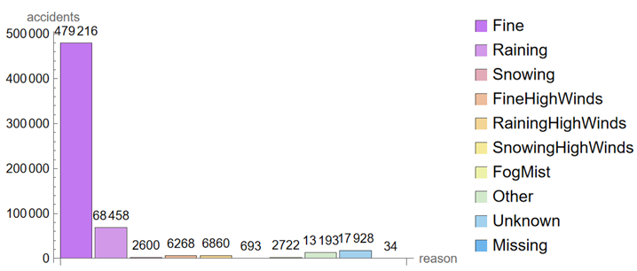
Result: Analysis based on Accident Severity and Weather Condition
Overall Analysis
Agenda : To know if weather conditions have any effect on the accident severity
Highest number of accidents caused in fine weather
Weather condition not the reason for the accidents caused

Slide 14
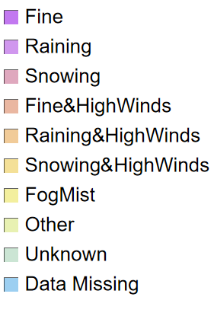
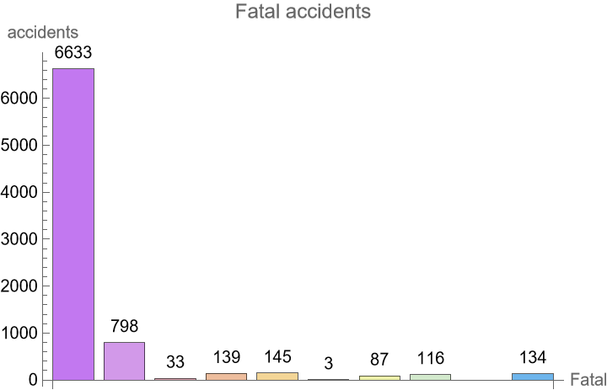
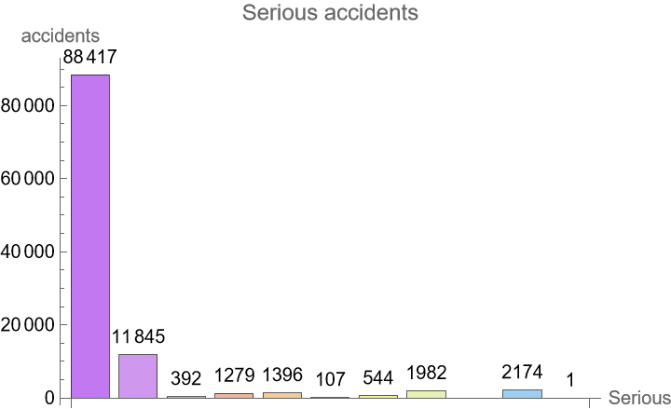
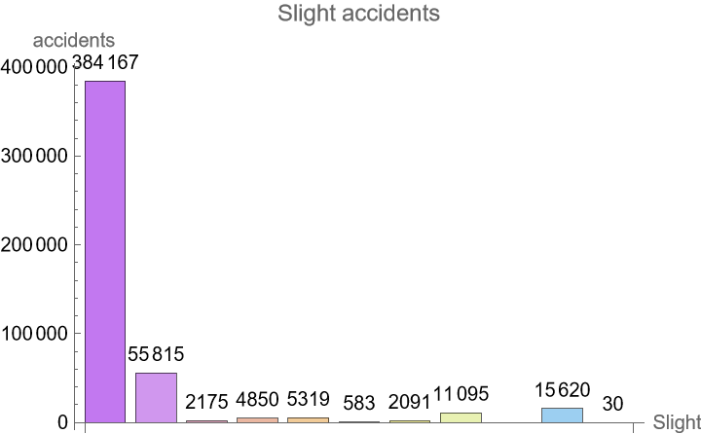
For all the levels of severity, highest number of accidents in fine weather
Functions used:
Part function is used twice.
all the rows , with weather conditions and year columns
all the rows for all weather conditions considering each severity separately.
Count: to count the number of accidents under each case.
Axeslabel, LabelingFunction, ChartLabels and PlotLabels for labelling enhancements in the chart.

Slide 15
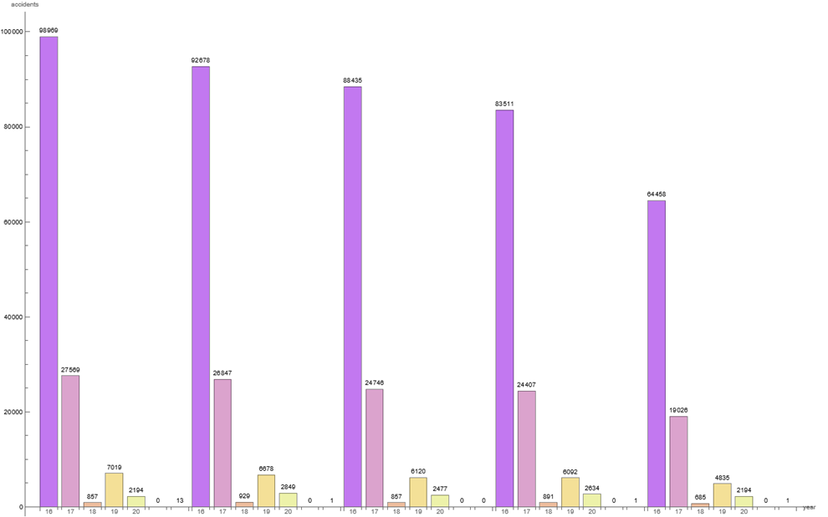
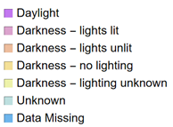
Result: Light Conditions
The Highest Light condition for most accidents is during the day.
From the Bar Chart it means that most accidents happen either in daylight or when streetlights are present and lit in the darkness.
Light conditions cannot be considered as a reason for accidents taking place.

Slide 16
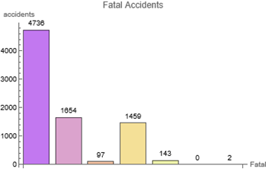
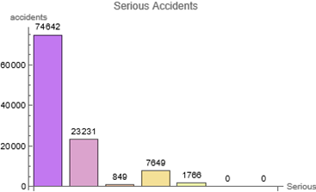
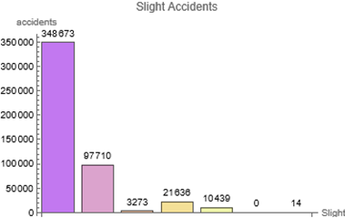
Result: Accident Severity by Light Conditions
Light conditions contribute to the severity of accidents.
Knowing the severity of an accident in different light scenarios can help to understand if the frequency of these accidents are due to lack of service or human error.
Knowing the severity of an accident in different light scenarios can help to understand if the frequency of these accidents are due to lack of service or human error..
The number of fatal accidents due to light conditions is less compared to the fatal accidents caused by weather conditions

Slide 17
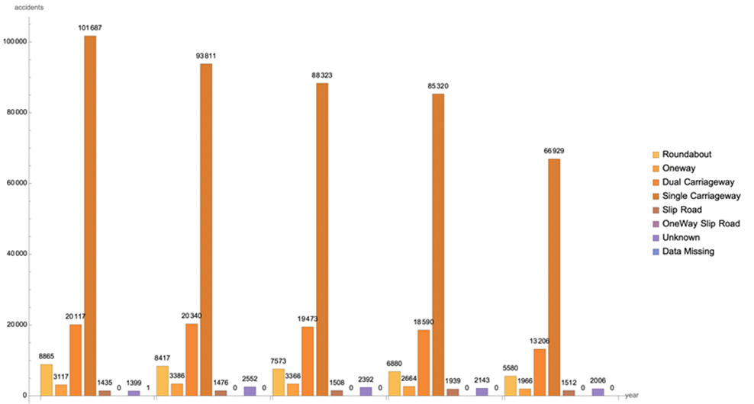
Road Type
Shows that the maximum number of accidents are caused in ‘Single Carriageway’ with 101687 accidents in 2016, and then consistently reducing over the years to 66929 in 2020.
‘Dual Carriageway’ being the second highest in causing the most accidents shows a slight increase in 2017 and then reduced each year moving forward.
’Slip Road’ has not caused many accidents over the past 5 years but needs to be put into consideration as there has been a slight increase each year in the number of accidents caused by it.

Slide 18
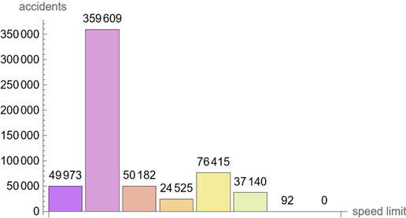
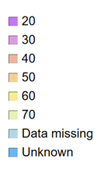
Speed Limits
Speed Limits can be considered to have quite an influence on the number of road accidents.
The fatal accidents are seen to be highest on roads having a speed limit of 60mph and lowest at 20mph.
. On the other hand, serious and slight accidents are seen to be highest on roads having a speed limit of 30mph and lowest at 50mph

Slide 19
Conclusion and Further Work
By the above analysis:
Short-term analysis:
Decrease in the number of accidents from 2016 to 2019
A sudden and drastic decline in the number of accidents after imposing pandemic lockdown in 2020
Long-term analysis:
Most of the accidents was found to happen on Friday’s
Huge reduction of serious and fatal accidents in 2020
More accidents took place during fine weather and appropriate lighting conditions
However, weather conditions seems to affect the number of fatal accidents more than light conditions
Most of the accidents happen on single carriageway than dual carriageway roads
Most of the accidents happen in area with a time limit of 30mph but fatality is highest at the speed limit of 60mph

Slide 20
Conclusion and Further Work
Further work:
Short-term analysis:
As the first lockdown imposed differed from locations e.g. Scotland and England
Therefore, future analysis should take the location of accidents into account to examine the effects on lockdown and restrictions
Attention should be given to selecting additional and more appropriate statistical methods other than t-test for this data
Long-term analysis:
Running more advanced correlations with multiple accident related circumstances to draw more detailed conclusions and ways of preventing accidents in future
Separate the accidents by vehicles

Slide 21
Thank You

